Slide 1

SRP Workshop on Ethical Dimensions of the
Radiological Protection System
June 2014

Slide 2









ICRP / IRPA Cooperative Effort
Task Group 94 on Ethics
of Radiological Protection

Slide 3
Background / Timeline
2009 – ICRP Committee 4 establishes a Working Party to reflect on the ethics of radiological protection
2012 – ICRP Main Commission formally initiates collaborative effort on philosophy of radiological protection, inviting IRPA to collaborate
Aug 2013 – 1st Asian workshop, Daejeon, Korea
Oct 2013 – ICRP Task Group 94 on Ethics of Radiological Protection is established
Dec 2013 – 1st European workshop, Milan, Italy
Jun 2014 – 2nd International Symposium on Ethics of Environmental Health, Budweis, Czech Republic (OPERRA Workshop on Ethics of Radiation Protection)
Jul 2014 – 1st North American workshop, Baltimore, USA

Slide 4
ICRP Task Group 94
Ethics of Radiological Protection
Mandate
Develop an ICRP publication presenting the ethical foundations of the system of radiological protection
Consolidate the basis of the Recommendations
Improve the understanding of the system
Provide a basis for communication on radiation risk and its perception

Slide 5
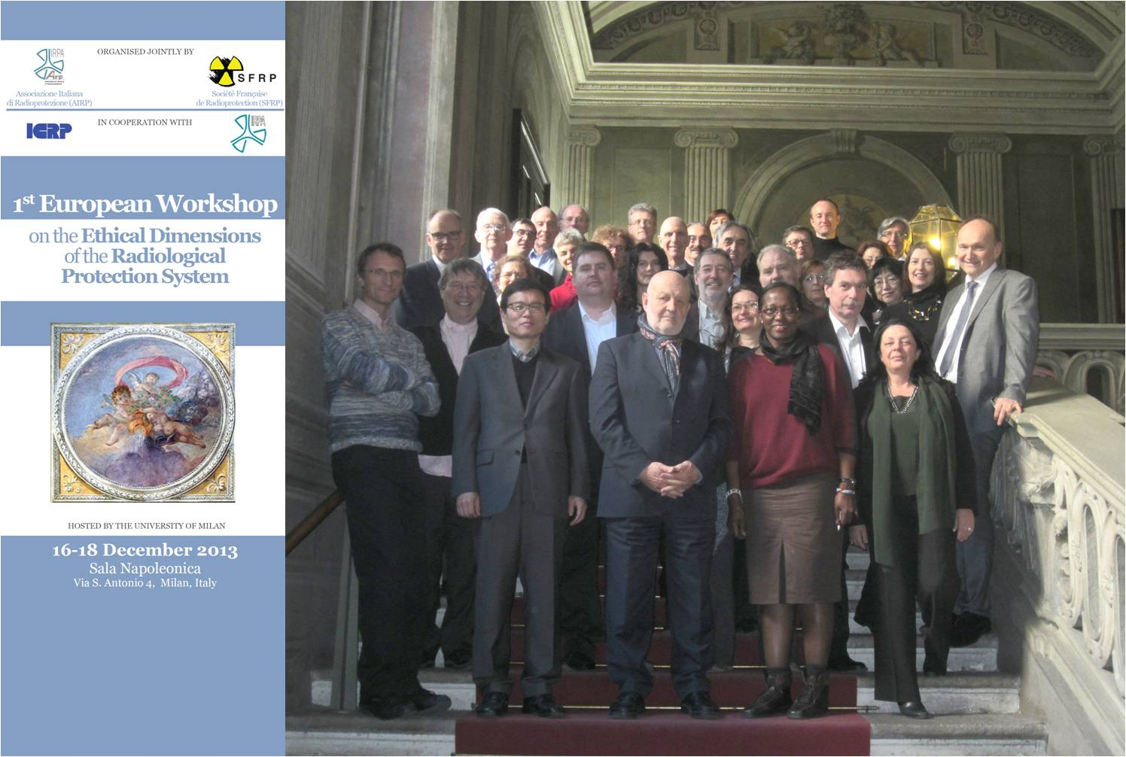

Slide 6

Workshop Objectives
To share the current reflections about ethical dimensions of the radiological protection system.
This will be undertaken through exploring the ethical values currently within the system of protection and through ‘shedding light’ on different aspects of practical implementation that raise ethical questions and value judgments.
The outcome from the workshop will contribute to the joint ICRP/IRPA review of ethics and values within the management of radiation risk, including the aim of improving the understanding and communication of the system. It will seek to build on the output from the Milan Workshop in December 2013, and will provide a basis for further discussion at the upcoming Geneva IRPA Regional Congress in June.

Slide 7
Today’s Agenda
0915-0930 Welcome by RC, round table introductions, scene setting
0930-1015 Ethical Basis of RP: Jacques Lochard
1015-1100 Further Reflections: Roger Coates
1100-1115 Coffee, including sign up for the three WGs
1115-1200 Radiation Protection and Professional Ethics: Jim Thurston
1200-1215 WG aims and objectives – including balancing the three groups
1215-1245 Lunch (and collect thoughts)
1245-1530 Working Groups
1530-1615 Feedback from WGs
1615-1645 Conclusions

Slide 8
Group A: Ethics within the System of Protection
Given that the three fundamental principles of RP (Justification, Optimisation and Limitation) have clear ethical underpinning, what other ethical values should be reflected in the System of Protection?
Are these values (i) evidently present , (ii) present but hidden, or (iii) absent from the current System of Protection?

Slide 9
Group B: Ethics in the application of the System (‘Professional Ethics’)
What are the ethical challenges in the practical application of the System of Protection in the various fields of practice (medical, nuclear, etc)?
What are the common challenges across these fields?
How can we best ensure ethical behaviour, and what are our ethical responsibilities as professionals in a Chartered Society?

Slide 10
Group C: Challenges to communication and understanding of radiation and risk
What are the principal challenges to effective communication and understanding of the System of Protection?
To what extent do these challenges link to the ethical basis of the System?
What needs to be done to have a firmer basis for communication and understanding?

